Slide 1
What Legal Protects under AI context?
Dong Xiaomeng
Han Kun Law Offices (Beijing, China)
Emai: Xiaomeng.dong@hankunlaw.com

Slide 2
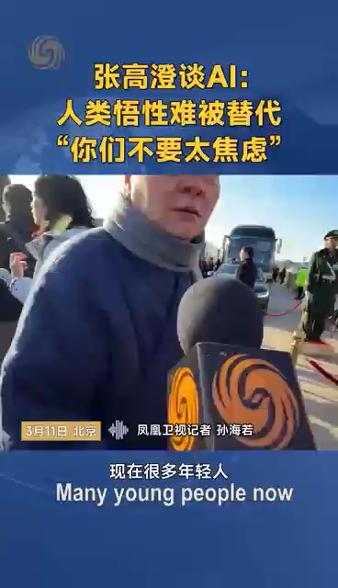
What Does the Legal Protect?
4%
– AI-generated knowledge
01
02
96%
– Human creations

Slide 3
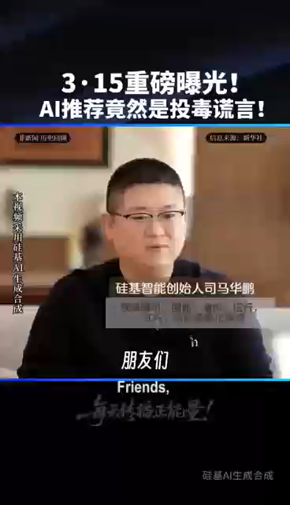
What Does the Law Protect?
"AI is merely an information container devoid of judgment.
In the AI era, what matters most is your independent thinking——stay skeptical, learn to cross-verify."

Slide 4
96% of Creation = Human Insight to Fulfill Ultimate Instructions
Current Model | Future Model
(1) Client submits a request. (I want to apply for Trademark A) | (1) The client’s ultimate instruction (e.g., a global trademark registration for cosmetics that embodies our company’s commitment to social responsibility; or “Design a self-portrait that makes me feel happy”)
(2) Law firm conducts a search. | (2) Law firms’ insight into client needs + advanced intuition guided by AI-driven questioning
(3) File application for the client. | (3) Delivering results to the client (For the client, receiving the trademark might feel like opening a blind box—will it match their ultimate vision?)

Slide 5

Future Value of Law Firms (Humans)
- How to Construct Prompts
- How to Select Responses from AI
How to Guide AI Tools to Generate Answers Closer to Perfect
… Human creative Outputs

Slide 6
Practice
Legally Protect Human Creative Outputs
(The 96% of Us)

Slide 7
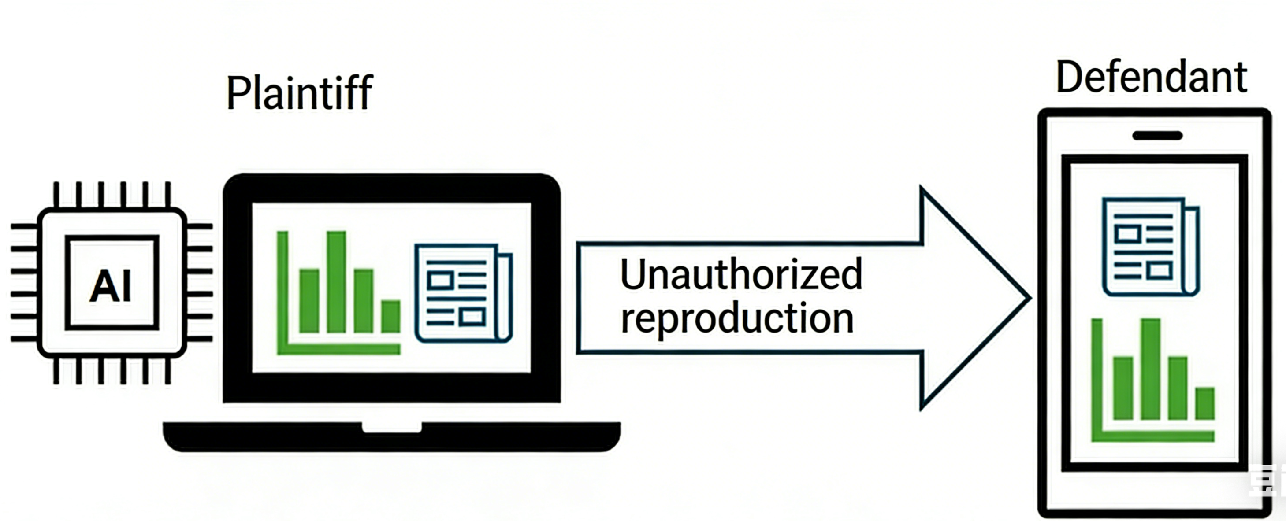
Case 1: China’s The First Case in the Field of AI Writing
use AI writing tool
generated a financial article & published it on its website.
Without the plaintiff’s permission, reproduced the article and published it on its website.

Slide 8
Case 1: China’s The First Case in the Field of AI Writing
The Court's Position
All carried out by members of the core creative team:
- selection and arrangement of data types and formats
- configuration of trigger conditions
- selection of article framework templates and the setting of text structure
- training of intelligent verification algorithm models

Slide 9
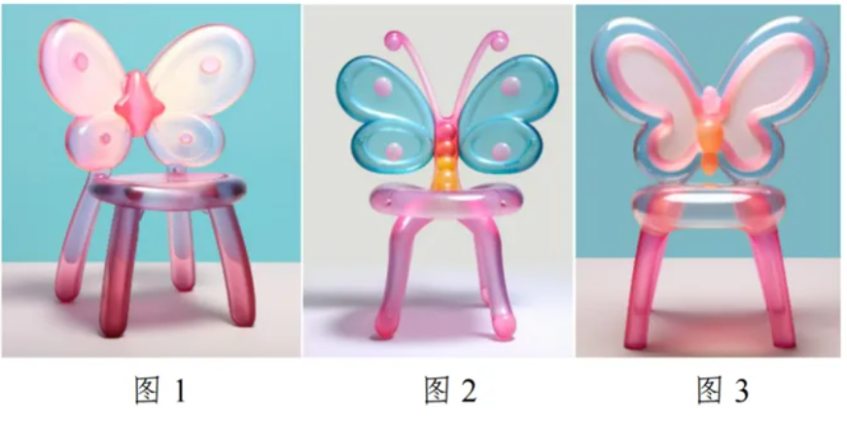
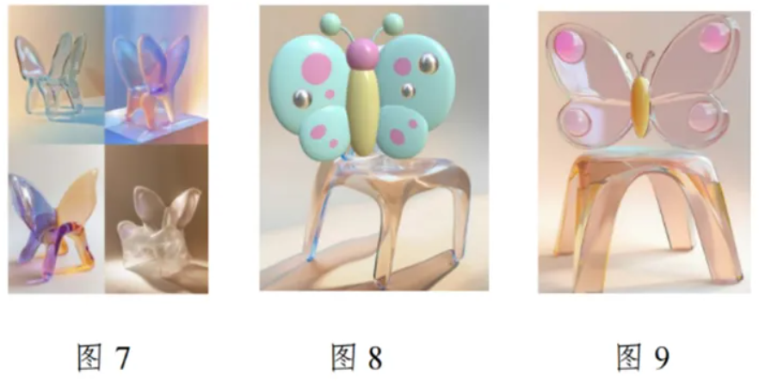
Case 2: China's First Case Ruling AI-Generated Images Do Not Constitute Works
The plaintiff: released three images of butterfly chairs generated using AI software (Figures 1–3).
The defendant:
referring to the plaintiff’s prompts
created images using AI software
designed physical products & sold online
The court:
plaintiff would be unable to reproduce exactly same images (Figs. 7–9) even if using the identical prompts
the plaintiff did not retain records of the creative process for the images
given the inherent randomness of AI-generated images
court ruled that No Intellectual Input- No protect by Law

Slide 10
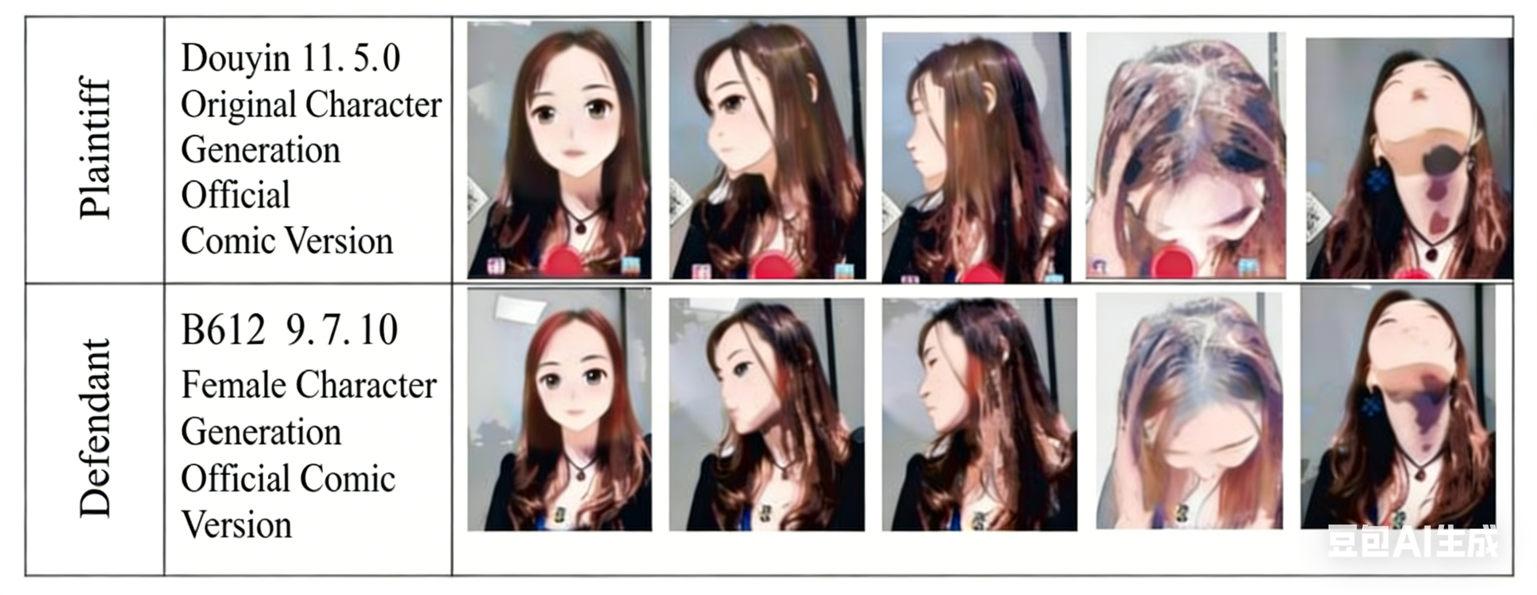
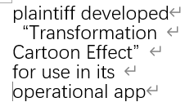
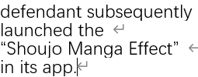
Case 3: China’s First Case Involving the Unauthorized Use of Another Party’s Model Structure and Parameters
Defendant directly uses Model Structure and Parameters of the Plaintiff

Slide 11
Case 3: China’s First Case Involving the Unauthorized Use of Another Party’s Model Structure and Parameters
The law protects AI models that embody the developers’ original ideas.
The court ruled that the special effects launched by defendant based on parameters of plaintiff, thereby harming plaintiff’s competitive interests and constituting unfair competition.
This case marks the first time a court has explicitly included model structures and parameters under the protection of the Anti-Unfair Competition Law

Slide 12
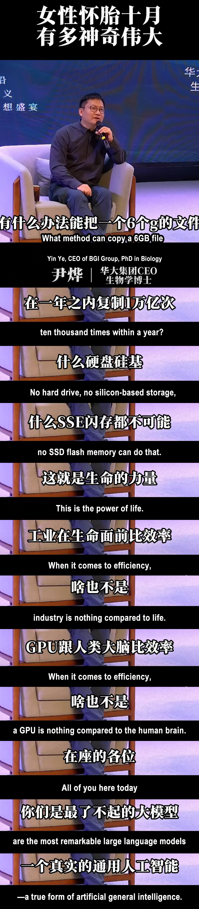
Conclusion
Humanity is the greatest large-scale model.
Law Protects Human Creativity under AI time-attitude from China

Slide 13
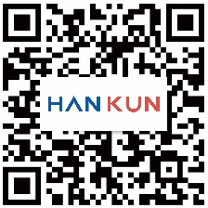
北京
北京市东城区东长安街1号
东方广场C1座9层
邮编：100738
电话：+86 10 8525 5500
传真：+86 10 8525 5511/5522
Email：beijing@hankunlaw.com
上海
上海市静安区石门一路288号 兴业太古汇香港兴业中心二座33层
邮编：200041
电话：+86 21 6080 0909
传真：+86 21 6080 0999
Email：shanghai@hankunlaw.com
深圳
深圳市福田区中心四路1-1号
嘉里建设广场第三座20层
邮编：518048
电话：+86 755 3680 6500
传真：+86 755 3680 6599
Email：shenzhen@hankunlaw.com
www.hankunlaw.com
香港
香港中环 皇后大道中15号置地广场
公爵大厦39楼3901-05室
电话：+852 2820 5600
传真：+852 2820 5611
Email：hongkong@hankunlaw.com
海口
海口市龙华区滨海大道105号 百方广场A座19层1903室
邮编：570100
电话：+86 898 3665 5000
传真：+86 898 3665 5011
Email：haikou@hankunlaw.com
武汉
武汉市洪山区珞喻路10号 群光中心31层3107-18室
邮编：430070
电话：+86 27 5937 6200
传真：+86 27 5937 6211
Email：wuhan@hankunlaw.com
新加坡
莱佛士坊1号#53-00
莱佛士坊一号1座
邮编：048616
电话：+65 6013 2999
传真：+65 6013 2998
Email：singapore@hankunlaw.com
纽约
Han Kun LLP
美国纽约市第五大道620号2层洛克菲勒中心
邮编：10020
电话：+1 646 849 2888
Email：newyork@us.hankunlaw.com

Slide 14
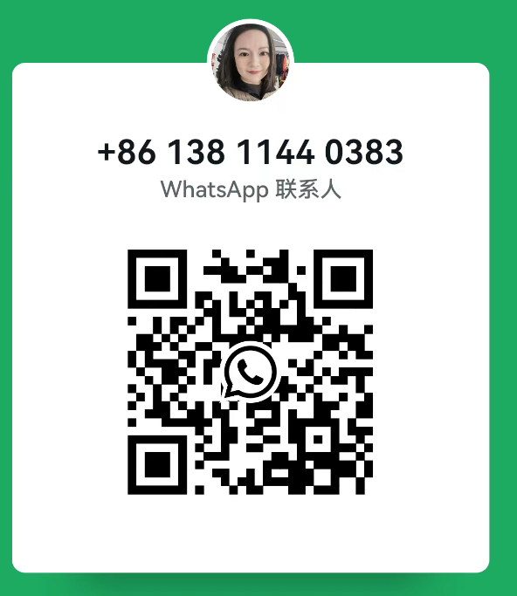
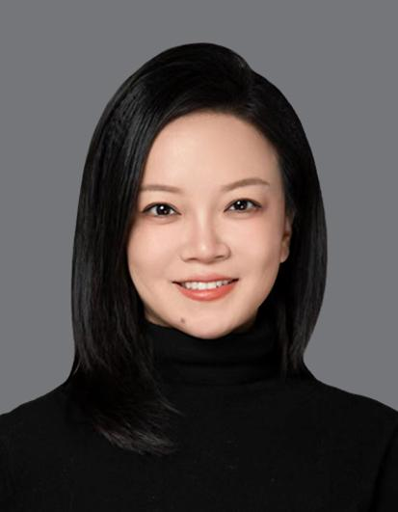
Let’s contact ☺
董晓萌
Han Kun Law Offices
13811440383
xiaomeng.dong@hankunlaw.com

